Slide 1
Communicating with the Database
Lesson 10

Slide 2


The Big Picture
Epic Communication Foundation (ECF)
Client
(Web)
Server
Database
(Server)
Chronicles
C#
M
Replaces RPC/Bulk RPC/Transaction
Modern, secure, portable, fast
RPCs and BulkRPCs can be reused, transactions must be replaced by ECF

Slide 3
Scenario
Load the cheese inventory from Chronicles
INI: XCH
Load only those for a specified country
Item: XCH-1000
Category
Regular item index
Item # Item Name Data Add Resp Indx Packed
1000 COUNTRY C N S Y 1000;1
1010 WEIGHT N N S N 1000;2
1020 PRICE N N S N 1000;3
2000 DESCRIPTION S N M N 2000;1;1
3000 IMAGE PATH SMALL S N S N 3000;1
3010 IMAGE PATH LARGE S N S N 3000;2
Country | Value
United States | 1
France | 61
United Kingdom | 182

Slide 4
Appendix A: ECF API Cheat Sheet
Remove from Companion

Slide 5
Agenda
Overview
Using basic ECF API
Using the BulkRPC Wrapper
Using Generated Code
Working with Chronicles

Slide 6
ECF Basics
class Request
{
public string Id { get; set; }
}
GetName n id,name s id=$$zECFGet("Id") i id="" q s id=$$getidin(id,"EMP") s name=$$znam("EMP",id) s %=$$zECFSet("Name",name) q
Execute Command
Command Response
Chronicles
Server
Database
class Response
{
public string Name { get; set; }
}

Slide 7
Bulk Name Change
class Request
{
public List<Employee> Employees { get; set; }
}
class Employee
{
public string Id {
get;
set;
}
public string Name {
get;
set;
}
}
Request
Employees
1
2
Id
Name
Id
Name
parent ➔ null, Employees is child of root request
UpdateNames n ln,employee,id,name
f ln=1:1:$$zECFNumElmts("Employees") d
. s employee=$$zECFGetElmt("Employees","",ln)
. s id=$$zECFGet("Id",employee)
. s name=$$zECFGet("Name",employee)
. ; Code to change record names...
parent ➔ node in request with object's properties

Slide 8

Request
Employees
1
2
Id
Name
Id
Name
Use $$zECFGetWasSent to distinguish "" from no value being sent.

Slide 9
Dictionary of Values
class Request
{
public Dictionary<string,string> Employees
{
get;
set;
}
}
Request
Employees
id1
id2
Name
Name
parent ➔ null, Employees is child of root request
UpdateNames n id,name
f s id=$$zECFDctNxKey("Employees","",id) q:id="" d
. s name=$$zECFGetElmt("Employees","",id)
. ; Code to change record names...

Slide 10
Request
Employees
id1
id2
Name
Name

Slide 11
Dictionary in an Object
class Request
{
public EmployeeCollection Employees { get; set; }
}
class EmployeeCollection
{
public Dictionary<string,string> EmployeeIds
{
get;
set;
}
}
Request
Employees
EmployeeIds
id1
id2
Flat requests and responses are faster
Don't add unnecessary sub-objects unless it makes sense to do so.
Name
Name
parent ➔ node in request with object's properties
UpdateNames n employees,id,name
s employees=$$zECFGet("Employees")
f s id=$$zECFDctNxKey("EmployeeIds",employees,id) q:id="" d
. s name=$$zECFGetElmt("EmployeeIds",employees,id)
. ; Code to change record names...

Slide 12
Request
Employees
EmployeeIds
id1
id2
Name
Name

Slide 13
Returning a List of Objects
class Response
{
public List<Employee> Employees { get; set; }
}
class Employee
{
public string Id { get; set; }
public string Name { get; set; }
}
Response
Employees
1
2
Id
Name
Id
Name
S: Single (not a collection)
A: Array
L: IList
D: IDictionary
T: Table (Epic-specific)
GetEmployees n ln,employeeList,id,name,employee
s employeeList=$$zECFNew("Employees","","L")
f s id=$$zoID("EMP",id) q:id="" d
. s employee=$$zECFNewElmtObj(employeeList)
. s %=$$zECFSet("Id",id,employee)
. s %=$$zECFSet("Name",$$znam("EMP",id),employee)

Slide 14
Response
Employees
1
2
Id
Name
Id
Name

Slide 15
Exercise
Experimenting with ECF
INI: XCH
Item # Item Name Data Add Resp Indx Packed
1000 COUNTRY C N S Y 1000;1
1010 WEIGHT N N S N 1000;2
1020 PRICE N N S N 1000;3
2000 DESCRIPTION S N M N 2000;1;1
3000 IMAGE PATH SMALL S N S N 3000;1
3010 IMAGE PATH LARGE S N S N 3000;2
Country | Value
United States | 1
France | 61
United Kingdom | 182

Slide 16
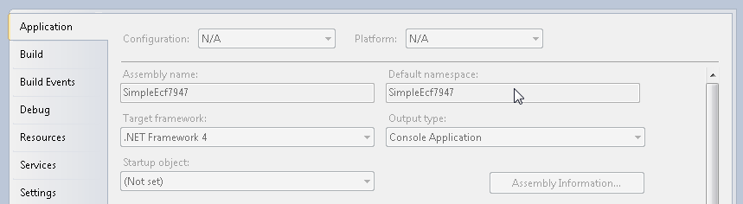

Slide 17
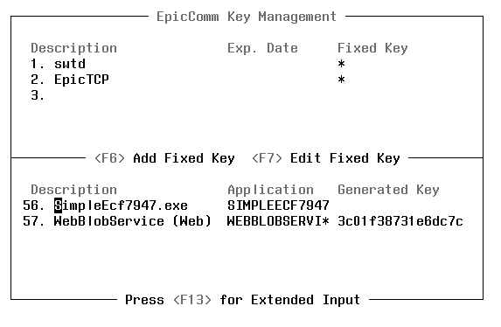
<TLG>.exe
<TLG>

Slide 18
Wrap Up
True or False: It is important that you limit request classes to only include properties that are necessary for the request.
True

Slide 19
Wrap Up
True or False: It is important that you limit response classes to only include properties that are necessary for the response.
False

Slide 20
Wrap Up
What is the significance of having to create a command before it can be used?
Control / Security

Slide 21
The [DateOnly] Attribute
Use with properties that serialize to Date items (DTEs in general)
Otherwise, dates will be 1 day off on the client (UTC conversion)

Slide 22
What You Learned
Read through the points covered
Ask if you have any questions

Slide 23
Agenda
Overview
Using basic ECF API
Using the BulkRPC Wrapper
Using Generated Code
Working with Chronicles

Slide 24
Executing a BulkRPC
string result;
FieldList fl = new FieldList() {
new SubFieldList() { "1", "2", "3" },
new CustomFieldList("|") {"X","Y","Z"} };
connection.BulkRpc("D tag^Routine", out result, fl.ToString());
Or use Connection.GetBulkDelimiter(level)
tag n sfl,cfl s sfl=$$zBulkNxF() ;1_C6_2_C6_3
s cfl=$$zBulkNxF() ;X|Y|Z s %=$$zBulkRep("I"_C6_"II"_C5_"a|b")
q
Execute BulkRPC
BulkRPC Response
Chronicles
Server
Database
Split on $C(5)
I_C6_II and a|b
ResultList fields= new ResultList(result, ResultType.Field);
ResultList subFields = new ResultList(fields.Piece(1), ResultType.Subfield);
ResultList customFields = new ResultList(fields.Piece(2),"|");
foreach (Result customField in customFields)
{
Console.WriteLine(customField.Value);
}
Split on $C(6)
I and II
Split on |
a and b

Slide 25
Converting the Result to Objects
public class EmployeeFactory: IResultListClassFactory<Employee>
{
public Employee Create(Result r)
{
Employee anEmployee = new Employee();
ResultList employeeItems = new ResultList(r.Value, ResultType.Subfield);
anEmployee.Id = employeeItems.NextPiece(); // same result as .Piece(1)
anEmployee.Name = employeeItems.NextPiece(); // same result as .Piece(2)
return anEmployee;
}
}
connection.BulkRpc("D GetEmployees^Example", out result, employeeIdFields);
ResultList resultList = new ResultList(result, ResultType.Field);
ObservableCollection<Employee> employees;
employees = resultList.ToObservableCollection<Employee, EmployeeFactory>();
Console.WriteLine("Employees:");
foreach (Employee e in employees)
{
Console.WriteLine(e.ToString());
}
Why create a factory class rather than adding a constructor to Employee?
- No need to share Employee ERD
- Avoid Employee (code) bloat

Slide 26
Exercise
BulkRPCs in ECF
INI: XCH
Item # Item Name Data Add Resp Indx Packed
1000 COUNTRY C N S Y 1000;1
1010 WEIGHT N N S N 1000;2
1020 PRICE N N S N 1000;3
2000 DESCRIPTION S N M N 2000;1;1
3000 IMAGE PATH SMALL S N S N 3000;1
3010 IMAGE PATH LARGE S N S N 3000;2

Slide 27
Exercise
Using BulkRPCs over ECF

Slide 28
What You Learned
Read through the points covered
Ask if you have any questions

Slide 29
Agenda
Overview
Using basic ECF API
Using the BulkRPC Wrapper
Using Generated Code
Working with Chronicles

Slide 30
Overview
Why use generated code?
Faster to write
Easier to maintain
Less error prone
Challenge
Paradigm shift
Learning curve
ECF CDO
Epic Communication Foundation & Chronicles Data Operations

Slide 31
How to Use
What You do:
Indicate Chronicles pieces
Map pieces to .NET classes
Create ECF Command
Write programming points (optional)
Is done for you:
Load/save data to Chronicles
Get ECF request & generate response

Slide 32
Get Employee Name
Load (from Chronicles)
;;#ECFGENERATE# ; Type: Load ; Tag: lemp ; INI: EMP ; ID: |Id ; Items: ; .2|Name ; EndItems ; EndINI ;;#ENDGEN#
class Request
{
public string Id { get; set; }
}
Execute Command
Command Response
Chronicles
lemp N ID S ID=$$zECFGet("Id") I ID']"" D lempCLEAR G lempDON S %=$$zECFSet("Name",^ER("EMP",ID)) lempDON ; Q lempCLEAR ; S %=$$zECFSet("Name","") Q
Server
Database
class Response
{
public string Name { get; set; }
}
Entry tag listed in command
Prefix for generated code
<= 4 Characters

Slide 33
Bulk Name Change
class Request
{
public List<Employee> Employees { get; set; }
}
class Employee
{
public string Id { get; set; }
public string Name { get; set; }
}
Request
Employees
1
2
Save to Chronicles
;;#ECFGENERATE# ; Type: Save ; Tag: sEMP ; INI: EMP/M|Employees ; ID: |Id ; Items: ; .2|Name ; EndItems ; EndINI ;;#ENDGEN#
Id
Name
Id
Name
/M: Process
Multiple Records

Slide 34
Full Syntax Overview
Command / INI
;#ECFGENERATE#
; Command: commandName
; Type: Load/Save
; Tag: TagName
; Storage: Local
; Protection: No
; Masking: No
; Parent: pp
; INI: XXX/flags|Property|START:pp~END:pp
; ID: /flags|RequestProperty~ResponseProperty|findIDpp
; DAT: /flags|RequestProperty~ResponseProperty|findDATpp
; Rec: BEFORE:pp~AFTER:pp~MID:pp~ABORT:pp
; Items:
; Item#/flags|Property~CommentProperty|PRE:pp~FRMT:pp~AFT:pp
; EndItems
; Fields:
; #/flags|Property|Fieldpp|otherInfo|associatedItem#
; EndFields
; EndINI
;#ENDGEN#
ID / DAT
Item
Field

Slide 35
Command / INI
ID / DAT
Item
Field

Slide 36
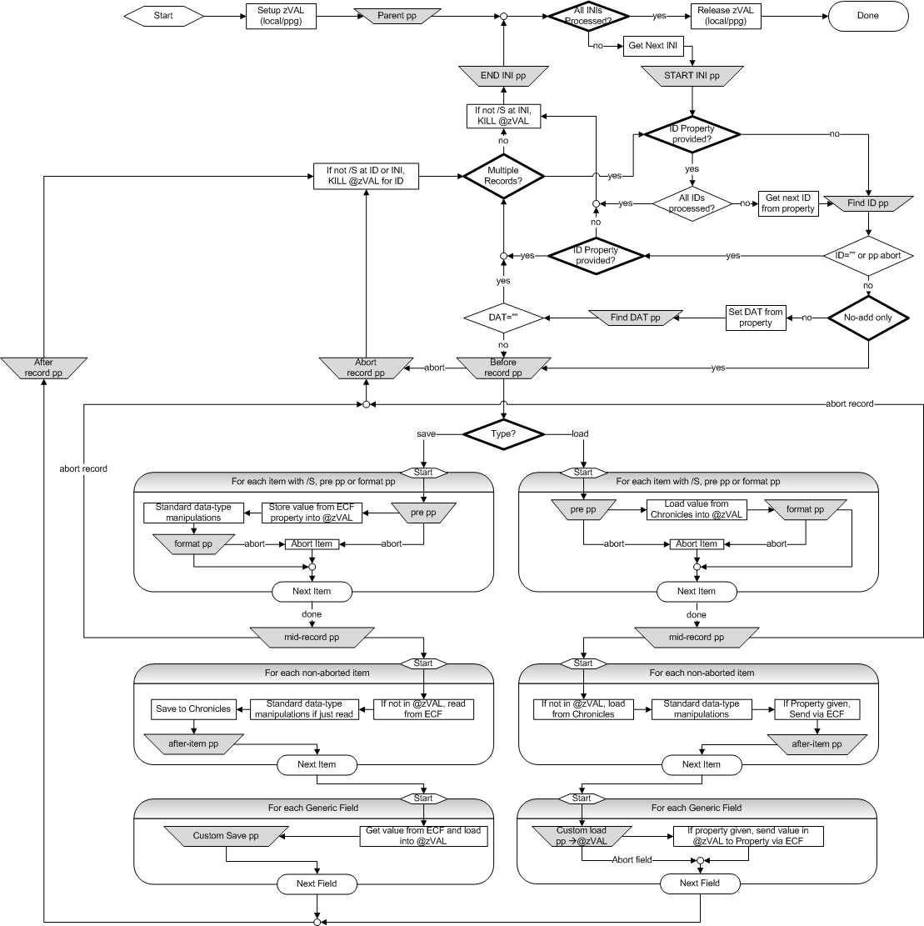

Slide 37
Command / INI Level
Data buffer
Reduces global hits
Omit to use ppg
Process INI (ID/DAT/Item/field levels)
;#ECFGENERATE# ; Command: Train.Instructor.ExampleEcfCdo ; Type: Load ; Tag: ld ; Storage: Local
; Parent: setParent
; Protection: No
; Masking: No ; INI: EMP/MLS|Employees|START:startEmp~END:endEmp
; EndINI
; INI: SER/M|Providers
; EndINI
;#ENDGEN#
Command calling this CDO
(optional) For documentation
Yes (default) EMFI item protection
Yes (default) Mask sensitive values (SSN)
EMP Comments (ID / DAT / Items / Fields)
L: Perform Lookback
S: Save info in buffer between INIs
SER Comments (ID / DAT / Items / Fields)
Why might you want to save data in zVAL between INIs?

Slide 38
The Generated Code
Take 30 seconds to answer the following three questions.
1. Why is zVAL set to a string?
Process INI (ID/DAT/Item/field levels)
ld ; N ID,DAT,INI,... N zVAL,tmpVAL S zVAL="tmpVAL" ld1 ; S INI="EMP" S %=$$startEmp() S recsID=$$zECFNew("Employees","","L") ;
; iterate over records / items...
; ld1DON ; S %=$$endEmp() ld2 ; S INI="SER" S recsID=$$zECFNew("Providers","","L") ;
; iterate over records / items ...
; K @zVAL@(INI,ID,DAT) G ld2ID ld2DON ; ldDON ; Q
;#ECFGENERATE# ; Command: Train.Instructor.ExampleEcfCdo ; Type: Load ; Tag: ld ; Storage: Local
; Parent: setParent
; Protection: No
; Masking: No ; INI: EMP/MLS|Employees|START:startEmp~END:endEmp
; EndINI
; INI: SER/M|Providers
; EndINI
;#ENDGEN#
2. Why is "L" used here?
EMP Comments (ID / DAT / Items / Fields)
SER Comments (ID / DAT / Items / Fields)
3. Why is zVAL killed after SER, but not EMP?

Slide 39
Command / INI
ID / DAT
Item
Field

Slide 40
ID / DAT Level
; INI: EMP/MLS|Employees|START:startEmp~END:endEmp
; ID: /S|IdIn~IdOut|findId ; DAT: |DatIn~DatOut|findDAT ; Rec: BEFORE:beforeEMP~AFTER:afterEMP~ABORT:abortEMP
Process Command / INIs
Step 4:
Clean up and move on to next record
Step 1:
Find the Record ID
Step 2: Find the DAT
Step 3: Load the Items
Process Items and Fields

Slide 41
ID / DAT Level
; INI: EMP/MLS|Employees|START:startEmp~END:endEmp
; ID: /S|IdIn~IdOut|findId ; DAT: |DatIn~DatOut|findDAT ; Rec: BEFORE:beforeEMP~AFTER:afterEMP~ABORT:abortEMP
S %=$$startEmp() S recsID=$$zECFNew("Employees","","L") S numIDs=$$zECFNumElmts("IdIn"),IDCnt=0 ld1ID ; S IDCnt=IDCnt+1 I IDCnt>numIDs G ld1DON S ID=$$zECFGetElmt("IdIn","",IDCnt) I '$$findId(.ID) G ld1ID I ID="" G ld1ID S DAT=$$zECFGetElmt("DatIn","",IDCnt) I '$$findDAT(ID,.DAT) G ld1ID I DAT="" G ld1ID I '$$beforeEMP() S %=$$abortEMP() G ld1ID ;
; Load Items/Fields for EMP
; S idID=$$zECFNewElmtObj(recsID) S %=$$zECFSet("IdOut",ID,idID) S %=$$zECFSet("DatOut",DAT,idID) S %=$$afterEMP() G ld1ID ld1DON ; S %=$$endEmp()
Omit IdIn to rely on findId to iterate over records
Omit IdOut if the result doesn't require record IDs

Slide 42
ID / DAT Level
; INI: EMP/MLS|Employees|START:startEmp~END:endEmp
; ID: /S|IdIn~IdOut|findId ; DAT: |DatIn~DatOut|findDAT ; Rec: BEFORE:beforeEMP~AFTER:afterEMP~ABORT:abortEMP
S %=$$startEmp() S recsID=$$zECFNew("Employees","","L") S numIDs=$$zECFNumElmts("IdIn"),IDCnt=0 ld1ID ; S IDCnt=IDCnt+1 I IDCnt>numIDs G ld1DON S ID=$$zECFGetElmt("IdIn","",IDCnt) I '$$findId(.ID) G ld1ID I ID="" G ld1ID S DAT=$$zECFGetElmt("DatIn","",IDCnt) I '$$findDAT(ID,.DAT) G ld1ID I DAT="" G ld1ID I '$$beforeEMP() S %=$$abortEMP() G ld1ID ;
; Load Items/Fields for EMP
; S idID=$$zECFNewElmtObj(recsID) S %=$$zECFSet("IdOut",ID,idID) S %=$$zECFSet("DatOut",DAT,idID) S %=$$afterEMP() G ld1ID ld1DON ; S %=$$endEmp()
Omit DatIn to rely on findDAT to identify the contact
Omit DatOut if the result doesn't require the DAT

Slide 43
ID / DAT Level
; INI: EMP/MLS|Employees|START:startEmp~END:endEmp
; ID: /S|IdIn~IdOut|findId ; DAT: |DatIn~DatOut|findDAT ; Rec: BEFORE:beforeEMP~AFTER:afterEMP~ABORT:abortEMP
S %=$$startEmp() S recsID=$$zECFNew("Employees","","L") S numIDs=$$zECFNumElmts("IdIn"),IDCnt=0 ld1ID ; S IDCnt=IDCnt+1 I IDCnt>numIDs G ld1DON S ID=$$zECFGetElmt("IdIn","",IDCnt) I '$$findId(.ID) G ld1ID I ID="" G ld1ID S DAT=$$zECFGetElmt("DatIn","",IDCnt) I '$$findDAT(ID,.DAT) G ld1ID I DAT="" G ld1ID I '$$beforeEMP() S %=$$abortEMP() G ld1ID ;
; Load Items/Fields for EMP
; S idID=$$zECFNewElmtObj(recsID) S %=$$zECFSet("IdOut",ID,idID) S %=$$zECFSet("DatOut",DAT,idID) S %=$$afterEMP() G ld1ID ld1DON ; S %=$$endEmp()

Slide 44
Activity
Take 60 seconds to answer the following:
Describe how you would load all EMP records matching a search string using an ECF CDO.
General idea (no code required)
How do you get the search string on the database?
How do you iterate?
What programming points would you use?

Slide 45
Use startEMP to get the search string from the request
Use findEmpID to iterate over matching IDs
;;#ECFGENERATE#
; Type: Load
; Tag: lemp
; INI: EMP/M|Employees|start:startEmp
; ID: |~Id|findEmpID
; Items:
; .2|Name
; EndItems
; EndINI
;;#ENDGEN#
startEmp() ;Get the search string and initialize
s %ySearch=$$zECFGet("SearchString")
s %yName=$$znxNm("EMP",%ySearch,-1)
s %yName=$$znxNm("EMP",%yName)
s %yID=""
q 1
findEmpID(ID) ;Return IDs until there are none
i $E(%yName,1,$L(%ySearch))'=%ySearch q 0
s %yID=$$znxNmID("EMP",%yName,%yID)
i %yID="" d ;No more IDs in current name
. s %yName=$$znxNm("EMP",%yName)
. i $E(%yName,1,$L(%ySearch))=%ySearch d
. . s %yID=$$znxNmID("EMP",%yName,%yID)
s ID=%yID
q ID'=""
Use %y* variables to maintain information between programming points
Are programming points called as functions or subroutines?
What would happen if you write them as if they were subroutines and not functions?

Slide 46
Command / INI
ID / DAT
Item
Field

Slide 47
Item Level
Process INI/ID/DAT
Step 1: Process items that
Require special code / formatting
Could cause abort of record
Step 2: Chance to abort record
Step 3: Finish processing items
Apply standard formatting
Save to Chronicles / Send via ECF
Process Fields

Slide 48
Item Level
Process INI/ID/DAT
Process Fields

Slide 49
Item Level
1
2
3

Slide 50
Item Level
; Rec: BEFORE:beforeEMP~AFTER:afterEMP~ABORT:abortEMP~MID:midEMP
; Items: ; 50/C|Status|PRE:before50~FRMT:format50~AFT:after50
; EndItems
Item Flags:
/R: Networked item (record). Epic.Core.Database.Record in .NET
/C: Item is a category. Epic.Core.Database.Category in .NET
/S: Save to @zVAL
/P: Skip formatting (date, time, etc.)
/T: Text item (presented as paragraph)
S abortLst="," I '$$before50() S abortLst=abortLst_50_"," I 1 E D . S @zVAL@(INI,ID,DAT,50)=^ER1("EMP",ID,50,99999,1) . I '$$format50() S abortLst=abortLst_50_"," I '$$midEMP() S %=$$abortEMP() G ld1ID S idID=$$zECFNewElmtObj(recsID) S %=$$zECFSet("IdOut",ID,idID) S %=$$zECFSet("DatOut",DAT,idID) I abortLst[",50," D . S %=$$zECFSet("Status","",idID) E D . S %=$$zECFSet("Status","",idID) . S val=@zVAL@(INI,ID,DAT,50) . I val'="" D .. S catID=$$zECFNew("Status",idID,"S") .. S cmt=$P(val,"[",2,99999),val=$P(val,"[",1) .. S %=$$zECFSet("Number",val,catID) .. S %=$$zECFSet("Comment",cmt,catID) .. S cat=^ED("EMP",50,"N",val) .. S %=$$zECFSet("Title",$P(cat,"^",1),catID) .. S %=$$zECFSet("Abbr",$P(cat,"^",2),catID) . S %=$$after50()
Take 30 seconds to answer the following :
1. Why is item 50 loaded before the mid-record programming point?
2. Why is Status an object with sub properties rather than just one value?

Slide 51
Item Level
; Rec: BEFORE:beforeEMP~AFTER:afterEMP~ABORT:abortEMP~MID:midEMP
; Items: ; 50/C|Status|PRE:before50~FRMT:format50~AFT:after50
; RelGroup: LocaleInfo
; 3400|Locale
; 3402|LoadCdaAtStartup
; EndRelGroup
; EndItems
Related Group Epic.Core.Database.RelatedTable<T>
T ➔Class with property for each item in group
public class Employee
{
RelatedTable<LocaleInfoRow> LocaleInfo { get; set; }
}
public class LocaleInfoRow
{
public string Locale { get; set; }
public string LoadCdaAtStartup { get; set; }
}

Slide 52
Item Level
; Rec: BEFORE:beforeEMP~AFTER:afterEMP~ABORT:abortEMP~MID:midEMP
; Items: ; 50/C|Status|PRE:before50~FRMT:format50~AFT:after50
; RelGroup: LocaleInfo
; 3400|Locale
; 3402|LoadCdaAtStartup
; EndRelGroup
; EndItems
S %=$$zECFSet("LocaleInfo","",idID) S relTblID=$$zECFNew("LocaleInfo",idID,"S") S lstID=$$zECFNew("Rows",relTblID,"L") S totalMin=1E25,totalMax=0 S total(3400)=^ER1("EMP",ID,3400,99999,0) I totalMin>total(3400) S totalMin=total(3400) I totalMax<total(3400) S totalMax=total(3400) S total(3402)=^ER1("EMP",ID,3402,99999,0) I totalMin>total(3402) S totalMin=total(3402) I totalMax<total(3402) S totalMax=total(3402) I totalMin=1E25 S totalMin=0 F lineCnt=1:1:totalMin D . S lineID=$$zECFNewElmtObj(lstID) . S %=$$zECFSet("Locale",^ER1("EMP",ID,3400,99999,lineCnt),lineID) . S %=$$zECFSet("LoadCdaAtStartup",^ER1("EMP",ID,3402,99999,lineCnt),lineID) F lineCnt=totalMin+1:1:totalMax D . S lineID=$$zECFNewElmtObj(lstID) . I total(3400)'<lineCnt D .. S %=$$zECFSet("Locale",^ER1("EMP",ID,3400,99999,lineCnt),lineID) . I total(3402)'<lineCnt D .. S %=$$zECFSet("LoadCdaAtStartup",^ER1("EMP",ID,3402,99999,lineCnt),lineID) K total,siCnt,siData,datLB

Slide 53
Item Level
; Rec: BEFORE:beforeEMP~AFTER:afterEMP~ABORT:abortEMP~MID:midEMP
; Items: ; 50/C|Status|PRE:before50~FRMT:format50~AFT:after50
; RelGroup: LocaleInfo
; 3400|Locale
; 3402|LoadCdaAtStartup
; EndRelGroup
; PropGroup: Demographics
; .2|Name
; 100/T|Address
; 14700/C|Sex
; EndPropGroup
; EndItems
Property Group
Property on parent with type T
T ➔Class with property for each item in group
Just one object (unlike related table)
Take 30 seconds to answer:
Why split properties into groups?
public class Employee
{
RelatedTable<LocaleInfoRow> LocaleInfo { get; set; }
public DemographicsInfo Demographics { get; set; }
}
public class LocaleInfoRow
{
public string Locale { get; set; }
public string LoadCdaAtStartup { get; set; }
}
public class DemographicsInfo
{
string Address { get; set; }
Category Sex { get; set; }
}

Slide 54
Item Level
; Rec: BEFORE:beforeEMP~AFTER:afterEMP~ABORT:abortEMP~MID:midEMP
; Items: ; 50/C|Status|PRE:before50~FRMT:format50~AFT:after50
; RelGroup: LocaleInfo
; 3400|Locale
; 3402|LoadCdaAtStartup
; EndRelGroup
; PropGroup: Demographics
; .2|Name
; 100/T|Address
; 14700/C|Sex
; EndPropGroup
; EndItems
S %=$$zECFSet("Demographics","",idID) S grpID=$$zECFNew("Demographics",idID,"S") S %=$$zECFSet("Name",^ER("EMP",ID),grpID) S propID=$$zECFNew("Address",grpID,"S") S %=$$zECFSet(propID,"") S crlf=$C(13)_$C(10) S total=^ER1("EMP",ID,100,99999,0) F lineCnt=1:1:total D . I lineCnt=total S crlf="" . S %=$$zECFSet(propID,^ER1("EMP",ID,100,99999,lineCnt)_crlf) S %=$$zECFSet("Sex","",grpID) S val=$p($p(^EN("EMP",ID,14700),$c(1),1),$c(2),2) I val'="" D . S catID=$$zECFNew("Sex",grpID,"S") . S cmt=$P(val,"[",2,99999),val=$P(val,"[",1) . S %=$$zECFSet("Number",val,catID) . S %=$$zECFSet("Comment",cmt,catID) . S cat=^ED("EMP",14700,"N",val) . S %=$$zECFSet("Title",$P(cat,"^",1),catID) . S %=$$zECFSet("Abbr",$P(cat,"^",2),catID)

Slide 55
Command / INI
ID / DAT
Item
Field

Slide 56
Generic Field Level
;Fields: ; 1/R|Record|GetRecordPp ; 2/CM|Categories|GetCategoryPp
; 3/T|Text|GetTextPp|80
;EndFields
Flags
R ➔ Record
C ➔ Category
M ➔ Multiple Response
T ➔ Text (max chars / line after pp)
Process Items
Save Load
Field
Field
Save/Load data not tied to a Chronicles item
Can use outside INI (specify XXX for INI)
Store in @zVAL@("Field#") or @zVAL@("Field#","Line#")

Slide 57
Command / INI
ID / DAT
Item
Field

Slide 58
Agenda
Overview
Using basic ECF API
Using the BulkRPC Wrapper
Using Generated Code
Working with Chronicles

Slide 59
Working With Chronicles
Access Manager
Check License and Security
Hyperspace Web wiki > Database > AccessManager
User Settings
Replaces EUserSettings in VB
Hyperspace Web wiki> Database > User Settings
Database Operations
Create, duplicate and delete records, create contacts, etc.
Hyperspace web wiki > Database > Database Objects > Chronicles Operations
Chronicles Database Definitions
Replaces EChronDBInfo and EChronItemInfo in VB
HyperspaceWeb wiki > Database > Database Definitions

Slide 60
Agenda
Overview
Using basic ECF API
Using the BulkRPC Wrapper
Using Generated Code
Working with Chronicles
Wrap Up

Slide 61
Wrap Up
Fill out Class Evaluations
https://training.epic.com/evaluations
Certification
Read Lesson 11
Project [Optional]:
http://wiki/main/Foundations/Training/.NET/C_Sharp_Project
C# Exam:
http://wiki/main/Foundations/Training/.NET/.NET_Exam
ECF Quiz:
http://wiki/main/Foundations/Training/.NET/ECF

Slide 62
Exercise
Using BulkRPCs over ECF
2. Working with ECF CDO

